Slide 1
This week work
Week 2 - April 14th

Slide 2
This week work
Week 2 - April 14th
Mateo
OpenWPM running on lab server
Reviewed Web background
Protocols, DNS, browsers workflow, resources, Cookies
Studied Ha’s Phd Thesis
CNAME, PII, OBA, web tracking mechanisms
Academic Reading:
I Always Feel Like Somebody’s Watching Me Measuring Online Behavioral Advertising (Carrascosa et. al, 2014)

Slide 3
I Always Feel Like Somebody’s Watching Me Measuring Online Behavioral Advertising
Authors:
Carrascosa, Mikians, Cuevas, Erramilli, Laoutaris
Year: 2014
Location: Spain

Slide 4
Context
Monetization of users information (advertising)
OBA: Online Behavioral “targeted” Advertising
Deliberately Tracking Users Activity
Threat to users
Privacy
Trust towards the web
The Tragedy of the Commons (Hardin): “the depletion of a shared resource due to individual self-interest”

Slide 5
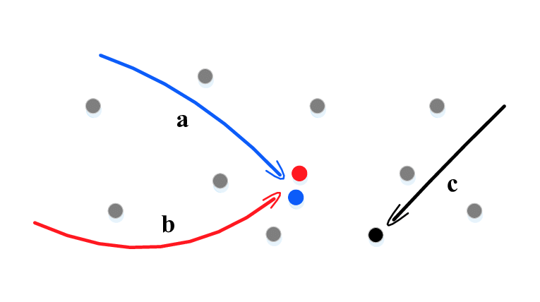
Main Purpose
To detect and measure OBA empirically

Slide 6
Difficulties
System technologies complexity
Unclear data collection
Untraceable Ad delivery
Not just online activity
Personal info
“Behaviors” are hard to define
How to categorize?

Slide 7
Research Contribution
OBA detection and characterization methodology
Frequency?
Profile-dependant targeting?
Sensitive Topic targeting?
Geolocation bias?
Privacy configurations effectiveness?

Slide 8
Research Contribution
Experiments results:
Frequency? ✅
Profile-dependant targeting? ✅
Sensitive Topic targeting? ✅
Geolocation bias? ❌
Privacy configurations effectiveness? ❌

Slide 9
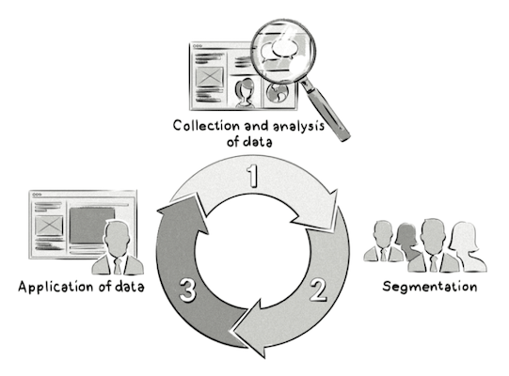
OBA Definition and Explanation
What?
Online advertising practice
Activity and interests
Specific profiles
Tailored ads

Slide 10

OBA Definition and Explanation
When?
Web browsing

Slide 11
OBA Definition and Explanation
Who?
Data aggregators (generic): capture activity and generate “behavior”
Ad-Networks: intermediaries

Slide 12
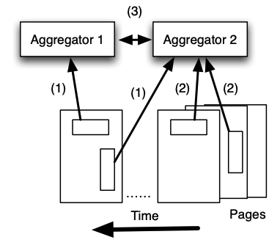
OBA Definition and Explanation
How?
Case 1: Show run-of-network ads (untailored)
Case 2: Use gathered data to deliver ads (tailored)

Slide 13
OBA Definition and Explanation
Other ways of advertisement:
Geographic: location
Demopgrahic: deducted from browsing history
Re-targeting: recent visited website topic
Contextual: actual website topic

Slide 14
Measurement Methodology Proposal
Goal:
“Uncover correlation between specific user behavioral trait and the ads shown to them.”

Slide 15
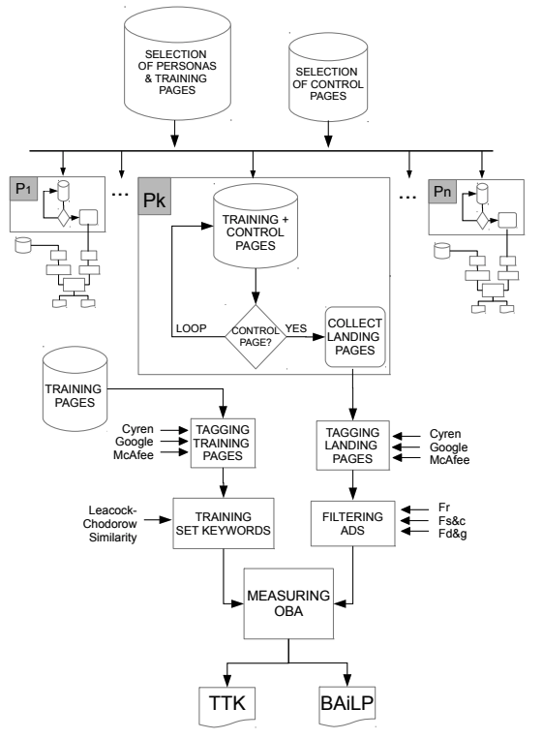
High Level Description of the Methodology
Steps:

Slide 16
Selection of Personas
and Training Pages

Slide 17
Selection of Personas and Training Pages
Artificial personas:
Narrow browsing behavior
Specific interests or theme
i.e “motor sports”
Resource: Google Adwords (now Google Ads)
Hierarchical categorization system (used by them)
2000+ specific categories (personas)
Each persona [130, 330] sites

Slide 18
Selection of Personas and Training Pages
240 personas taken (level 2)
Collect training pages for each persona “p”:
Remove ones with not exactly “p” keyword.
202 p’s remaining.
All websites: clean browser -> visit page -> see Google Ad Profile. Keep if at most 1 additional “p-related”.
104 p’s remaining.
Keep “p” if at least 10 training pages.
51 p’s remaining

Slide 19
Selection of Personas and Training Pages
Additional 21 “sensitive topics” personas (manually)
Same process, only “p” category

Slide 20
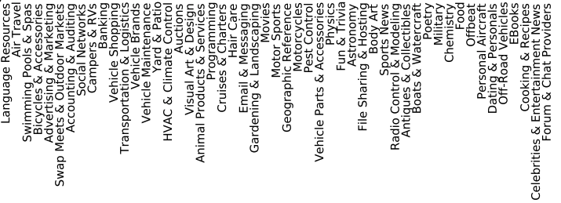
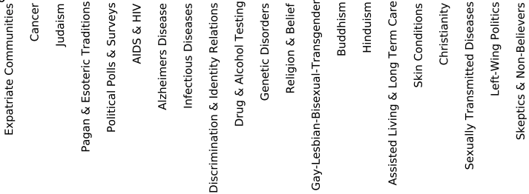
Selection of Personas and Training Pages

Slide 21
II. Selection of Control Pages:

Slide 22
II. Selection of Control Pages
5 Weather Pages:
Popular Ads
Few identifiable tags

Slide 23
III. Visiting Training and Control Pages

Slide 24
III. Visiting Training and Control Pages
Fresh installed browser
Random pick from (Training + Control) pages set
If Control Page: collect Ads’ Landing Page
(Different machine)
Exponential distribution (mean=3 min) between picks
Human-paced

Slide 25
IV. Tagging Training and Landing Pages

Slide 26
IV. Tagging Training and Landing Pages
3 different sources for each pages keywords (robustness):
Cyren
Google Adwords
McAfee
On each run only one is used, the others two are used to compare (next step)

Slide 27
V. Training Set Keywords

Slide 28
V. Training Set Keywords
For each page, keep only relevant keywords (at least 1 additional sources agreed with)
Agreement -> Leacock-Chodorow similarity.
Simplified:
Semantic similarity between two words
if S(k,l) > T -> “k” is similar to “l”
Parameters:
Threshold: T ∈ [0,3.68]
Sources: N ∈ Integer

Slide 29
VI. Filtering Different Types of Ads

Slide 30
VI. Filtering Different Types of Ads
Remove Landing Pages from non-OBA Ads.
Retargeting Ads: Trivial.
Known previous pages
Control pages only retarget Control or Training pages
=> Known Landing Pages retargets.

Slide 31
VI. Filtering Different Types of Ads
Static and Contextual Ads:
Clean profile
Static and Contextual ads for all pages
Remove overlap between “p” and clean “p”

Slide 32
VI. Filtering Different Types of Ads
Demographic-Geographic targeted Ads:
Same IP for all personas
Leacock-Chodorow similarity
Once between every pair of “p”.
For each persona:
For each landing page: S(k,l) with all other “p” with that landing page, given T’
If one is not similar, remove.

Slide 33
VII. Measuring the Presence and Representativeness of OBA

Slide 34

VII. Measuring the Presence and Representativeness of OBA
TTK (Targeted Training Keywords): Fraction of keywords targeted from p’s training pages given s
Measures exposure and OBA occurrence

Slide 35
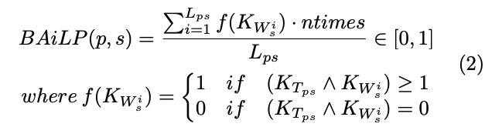
VII. Measuring the Presence and Representativeness of OBA
BAiL (Behavioral Advertising in Landing Pages): Fraction of Ads with at least 1 same keyword from p’s training pages
Measures percentage of OBA presence

Slide 36
Technologies and System
Lightweight Headless Browser PhantomJS, Chrome 26, Windows 7
No privacy protection
Except one complete run with Do Not Track activated
310 visits to control pages per persona (on avg.)
Different combinations of filters (Ads Removal)
Several values of T, N and T’
Located in Madrid, Spain

Slide 37
Performance
System validated against human results:
Two independent panelists
Random “p”s (few)
Classify Landing Pages as OBA vs non-OBA

Slide 38
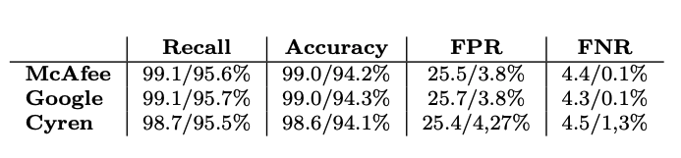
Performance
Results (max/min% across analyzed p’s):
*FPR < 10% for all personas except “Yard & Patio”.

Slide 39
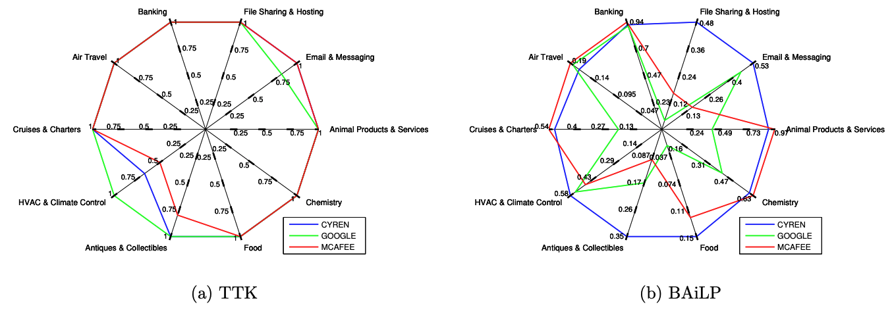
Experiments Results
TTK and BAiLP for 10 selected personas, all filters activated
TTK = 1 in 8 cases for 3 sources; TTK > 0.5 -> usually all training keywords targeted
BAiLP more heterogeneous for sources -> different labeling systems -> Google way more granular

Slide 40
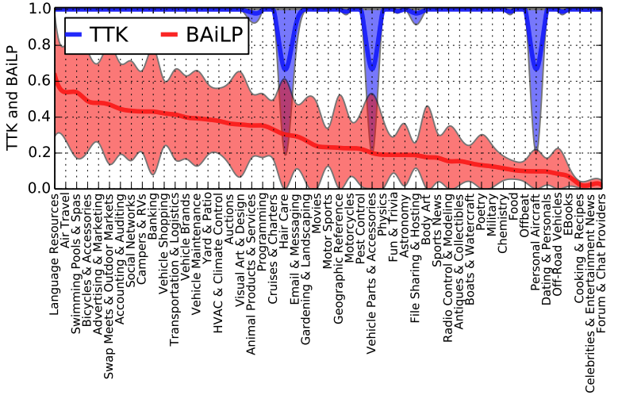
Experiments Results (Global)
All combinations possible (4 runs of 459 indep. exp.)
Avg and std dev (BAiLP sorted)
average TTK=1 For 88% of “p”, all keywords targeted ; TTK > 0.66 for the rest.
avg BAiLP: Half of “p” are exposed to 26-63% of targeted ads.

Slide 41
Experiments Results (Global)
All combinations possible (4 runs of 459 indep. exp.)
Avg and std dev (BAiLP sorted)
average TTK=1 For 88% of “p”, all keywords targeted ; TTK > 0.66 for the rest.
avg BAiLP: Half of “p” are exposed to 26-63% of targeted ads.
Strong OBA presence and high representativeness

Slide 42
Experiments Results (Global)
All combinations possible (4 runs of 459 indep. exp.)
BAiLP distributes: median = 0.23, IQR = 0,25, max = 0.63, min= 0.02
Some personas are targeted more intensively than others. Why?:
AdWords keyword planner -> suggested Cost per Click (bid value) for each persona.
Correlation between BAiLP and CPC:
Spearman = 0.44 p-value=0.004
Pearson = 0.4 p-value=0.007

Slide 43
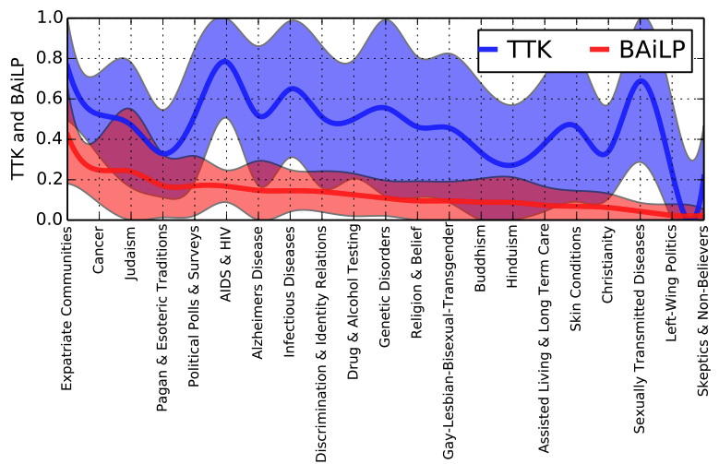
Experiments Results (Global)
Sensitive Personas (4 runs of 189 indep. exp.)
median TTK = 0.47 ; BAiLP between 10-40% for half of sensitive personas.
Run in Spain, where these topics are illegal in Europe -> values should be close to 0. Sensitive topics are tracked and used for OBA despite regulations

Slide 44
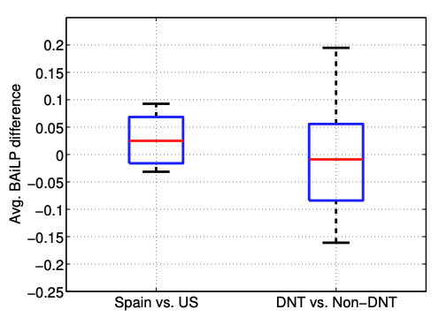
Experiments Results (Global)
Geographical Bias and Do Not Track
Above 0 is positive difference ; Below 0 negative.

Slide 46
I Always Feel Like Somebody’s Watching Me Measuring Online Behavioral Advertising (Carrascosa et. al, 2014)
Context
Monetization of users information (advertising)
OBA: Online Behavioral “targeted” Advertising
Deliberately Tracking
Threat to users
Privacy
Trust towards the web

